Slide 1
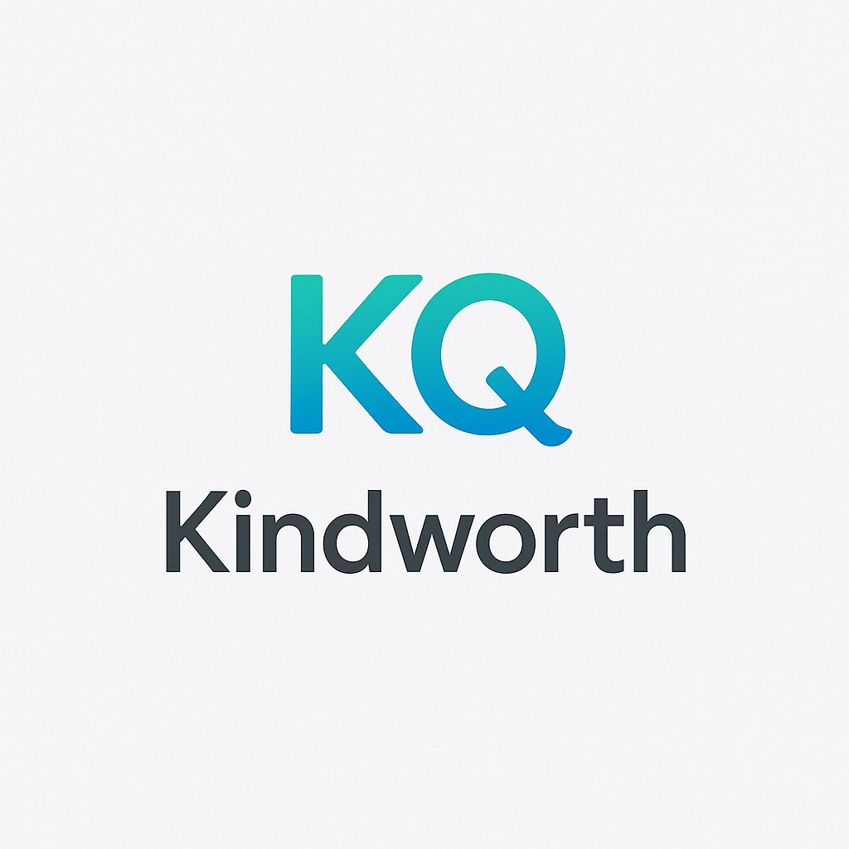
Kindworth – Investor Deck (VC-Level Visuals)

Slide 2
The Problem
Burnout and disengagement cost the global economy $322B annually. Emotional intelligence is the strongest predictor of leadership — but remains invisible in traditional metrics. Culture can't be measured until it's already broken.

Slide 3
The Opportunity
- $81B global HR tech market by 2030 - 70% of engagement tied to manager behavior - EQ-driven teams retain and outperform by 20%+ - Organizations want to quantify DEI, culture, and trust

Slide 4
Our Solution
Kindworth is a behavioral data engine that scores emotional intelligence at work. We capture and score daily kindness, support, and team-first behavior from Slack, Teams, and manual logs. Our fixed 100-point Kindness Quotient (KQ) makes EQ measurable.

Slide 5
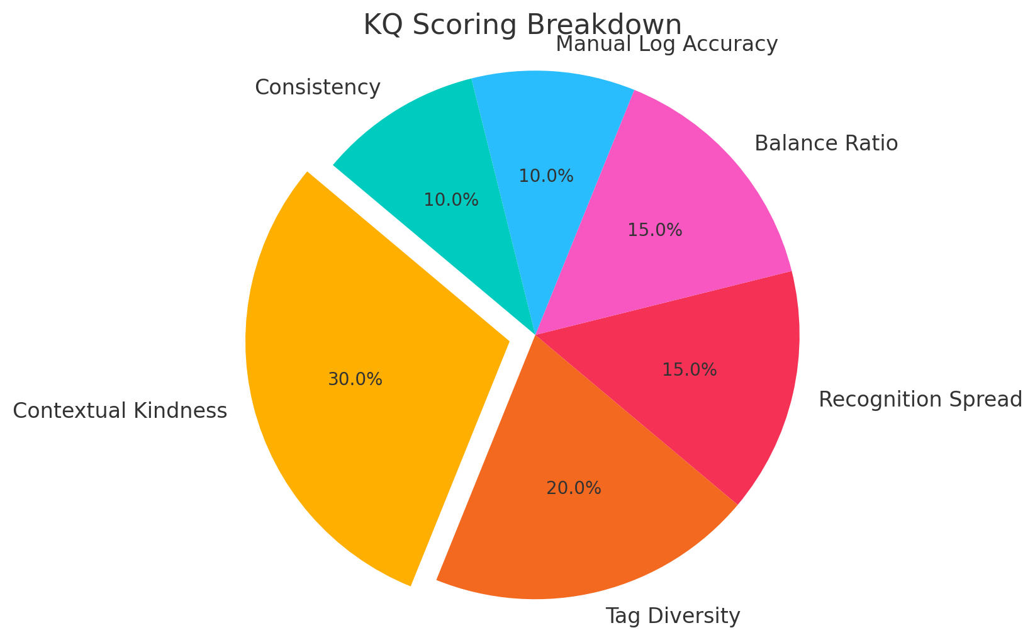
KQ Scoring Breakdown

Slide 6
Product Snapshot
- KQ Scorecard: Fixed 100-point performance signal - Inputs: Slack NLP + manager-approved manual logs - Scoring: Context, novelty, diversity, spread - Role-specific dashboards for Employees, Managers, HR

Slide 7
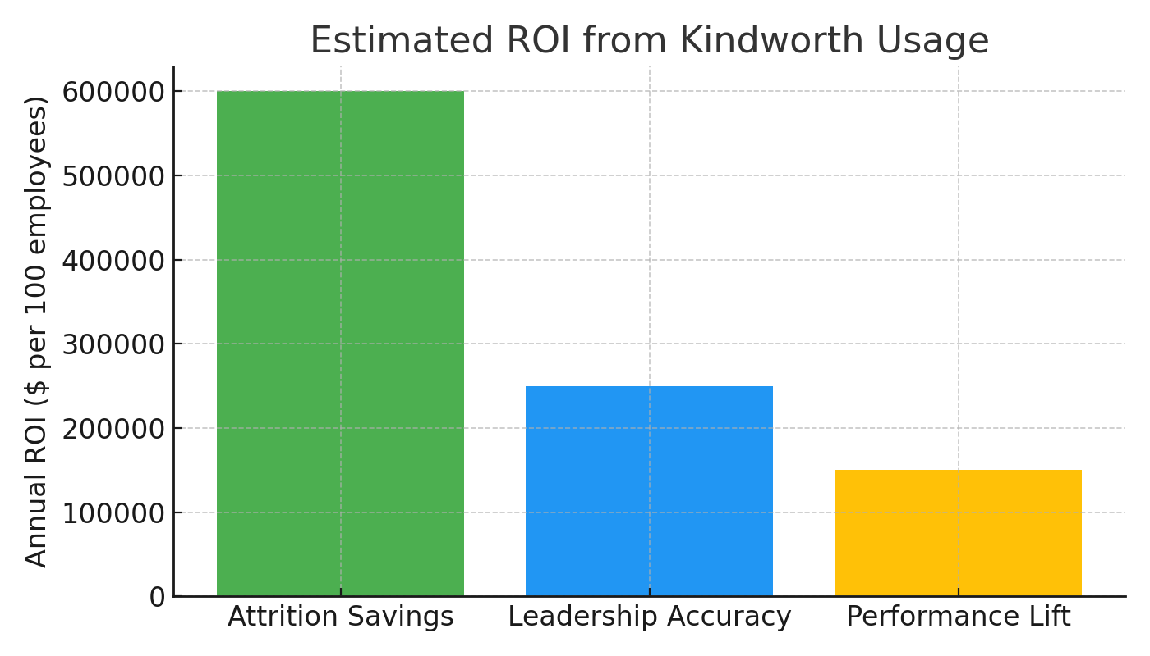
ROI Potential

Slide 8
Business Model
- B2B SaaS pricing (per-seat monthly) - Upsell modules: team health analytics, manager enablement - Expansion motion: Start with one team, scale org-wide - Ideal Customers: Values-led, remote-first teams

Slide 9
Competitive Advantage
- Not a badge system — it’s structured EQ intelligence - Governed score model with escalation, approval, and audit trail - Plugs into Slack, Teams — no extra tools needed - Proprietary scoring matrix and signal capture pipeline

Slide 10
Roadmap & Traction
- Scoring logic and architecture are complete - NLP + Slack prototype built - Early advisors aligned - Q4 roadmap: Launch MVP with 5 paid pilots

Slide 11
Funding & Use of Proceeds
Pre-seed Round: $1,000,000 Funds usage: - Complete MVP and dashboards - Run operations for 12 months - Launch with 5 paid pilot clients - Refine KQ signal scoring and performance APIs

